Slide 1
Intrusion Detection And Alerting System
Project Batch Members:
Resu Sri Sai Kumar(18B81A0251)
M.Chakri Sai Narayana(18B81A0210)
K.Sai Teja(17B81A0275)
Project Guide:
Mr. P. Rajesh Kumar
Associate Professor,
EEE Department.

Slide 2
Objective
Technology has changed the world. There is a huge growth in technology connected to almost every field. The pace and diversity of advancement are very rapid. Hence, new technology and techniques are coming up and are put to use as per the need.
Nowadays, there are many reports on the security issues at home or even residence such as burglary cases and fire accidents. Due to this, home security becomes a critical issue in today’s modern living styles.
Thus, it is important for the home owners to monitor any unwanted or illegal activities that occur at their home using a home surveillance system.
In such an advanced scenario, providing security to the home has also become a major point of concern.
Hence, a home security system that works over IoT and alerts the user over the internet is proposed.

Slide 3
Introduction
This project is aimed to provide security to the users by detecting a possible intruder and alerting the user.
With the perception that an efficient home surveillance system is crucially needed, therefore real-time notification system is so crucial for the home or residence owner.
And also fire detection and alarm system is very important to avoid major accidents which are caused due to fire. Fire may cause a big loss or damage to any property, home, companies, warehouses, malls or bazaar. It also causes severe injuries to human lives.
Therefore, by utilizing the Raspberry Pi device, this project will develop an intelligent system for home surveillance with the intention to help users in taking care of their home or residence.
The security system is developed using Ultrasonic Sensor and PI Camera and Flame Sensor.
When an intruder is detected, the developed system will recognize the intruder using PIR sensor or ultrasonic sensor and alerts the user by sending an email to the user along with the photo of intruder and it will alert the user via email if any fire accident is detected.

Slide 4
Operation
The concept of intrusion detection is achieved by Ultrasonic sensor or PIR sensor. The entire system is controlled by a Raspberry Pi.
As soon as an intruder is spotted, the sensor sends its data to the Raspberry Pi.
Then the Raspberry Pi will capture an image with the connected camera and stores the image in Raspberry Pi memory card.
And an email is delivered to the user, along with a photo of the intruder captured by the Pi camera along with the email the device also gives voice alerts to alert the locality.
Fires in the early detection and warning are two important ways to extinguish the fire promptly and avoid great casualties and property loss.
Therefore, the requirement of placing intelligent fire alarm system is important within buildings especially in the buildings where contain many people inside or valuable belongings.

Slide 5
A flame sensor is used to detect the possible fire, the flame sensor module can detect flames in the 760 – 1100 nano meter wavelength range. Small flames like a lighter flame can be detected at roughly 0.8m. The detection angle is roughly 60 degrees and the sensor is particularly sensitive to the flame spectrum.
As soon as a flame is detected, it sends signals to Raspberry Pi and then the Raspberry Pi sends voice alerts using a speaker to alert the locality and an email is also sent to the user to alert the user.
This system can be installed at the main door of your home or office and you can monitor it from anywhere in the world using your Email over the internet.
Users can also view the live feed of the security camera from anywhere.
Using an open-source service called RPI Cam Web Interface, user can start real-time video streaming from any device.
The latency of this video streaming will be very low and it can be accessed from any smart device using web.

Slide 6




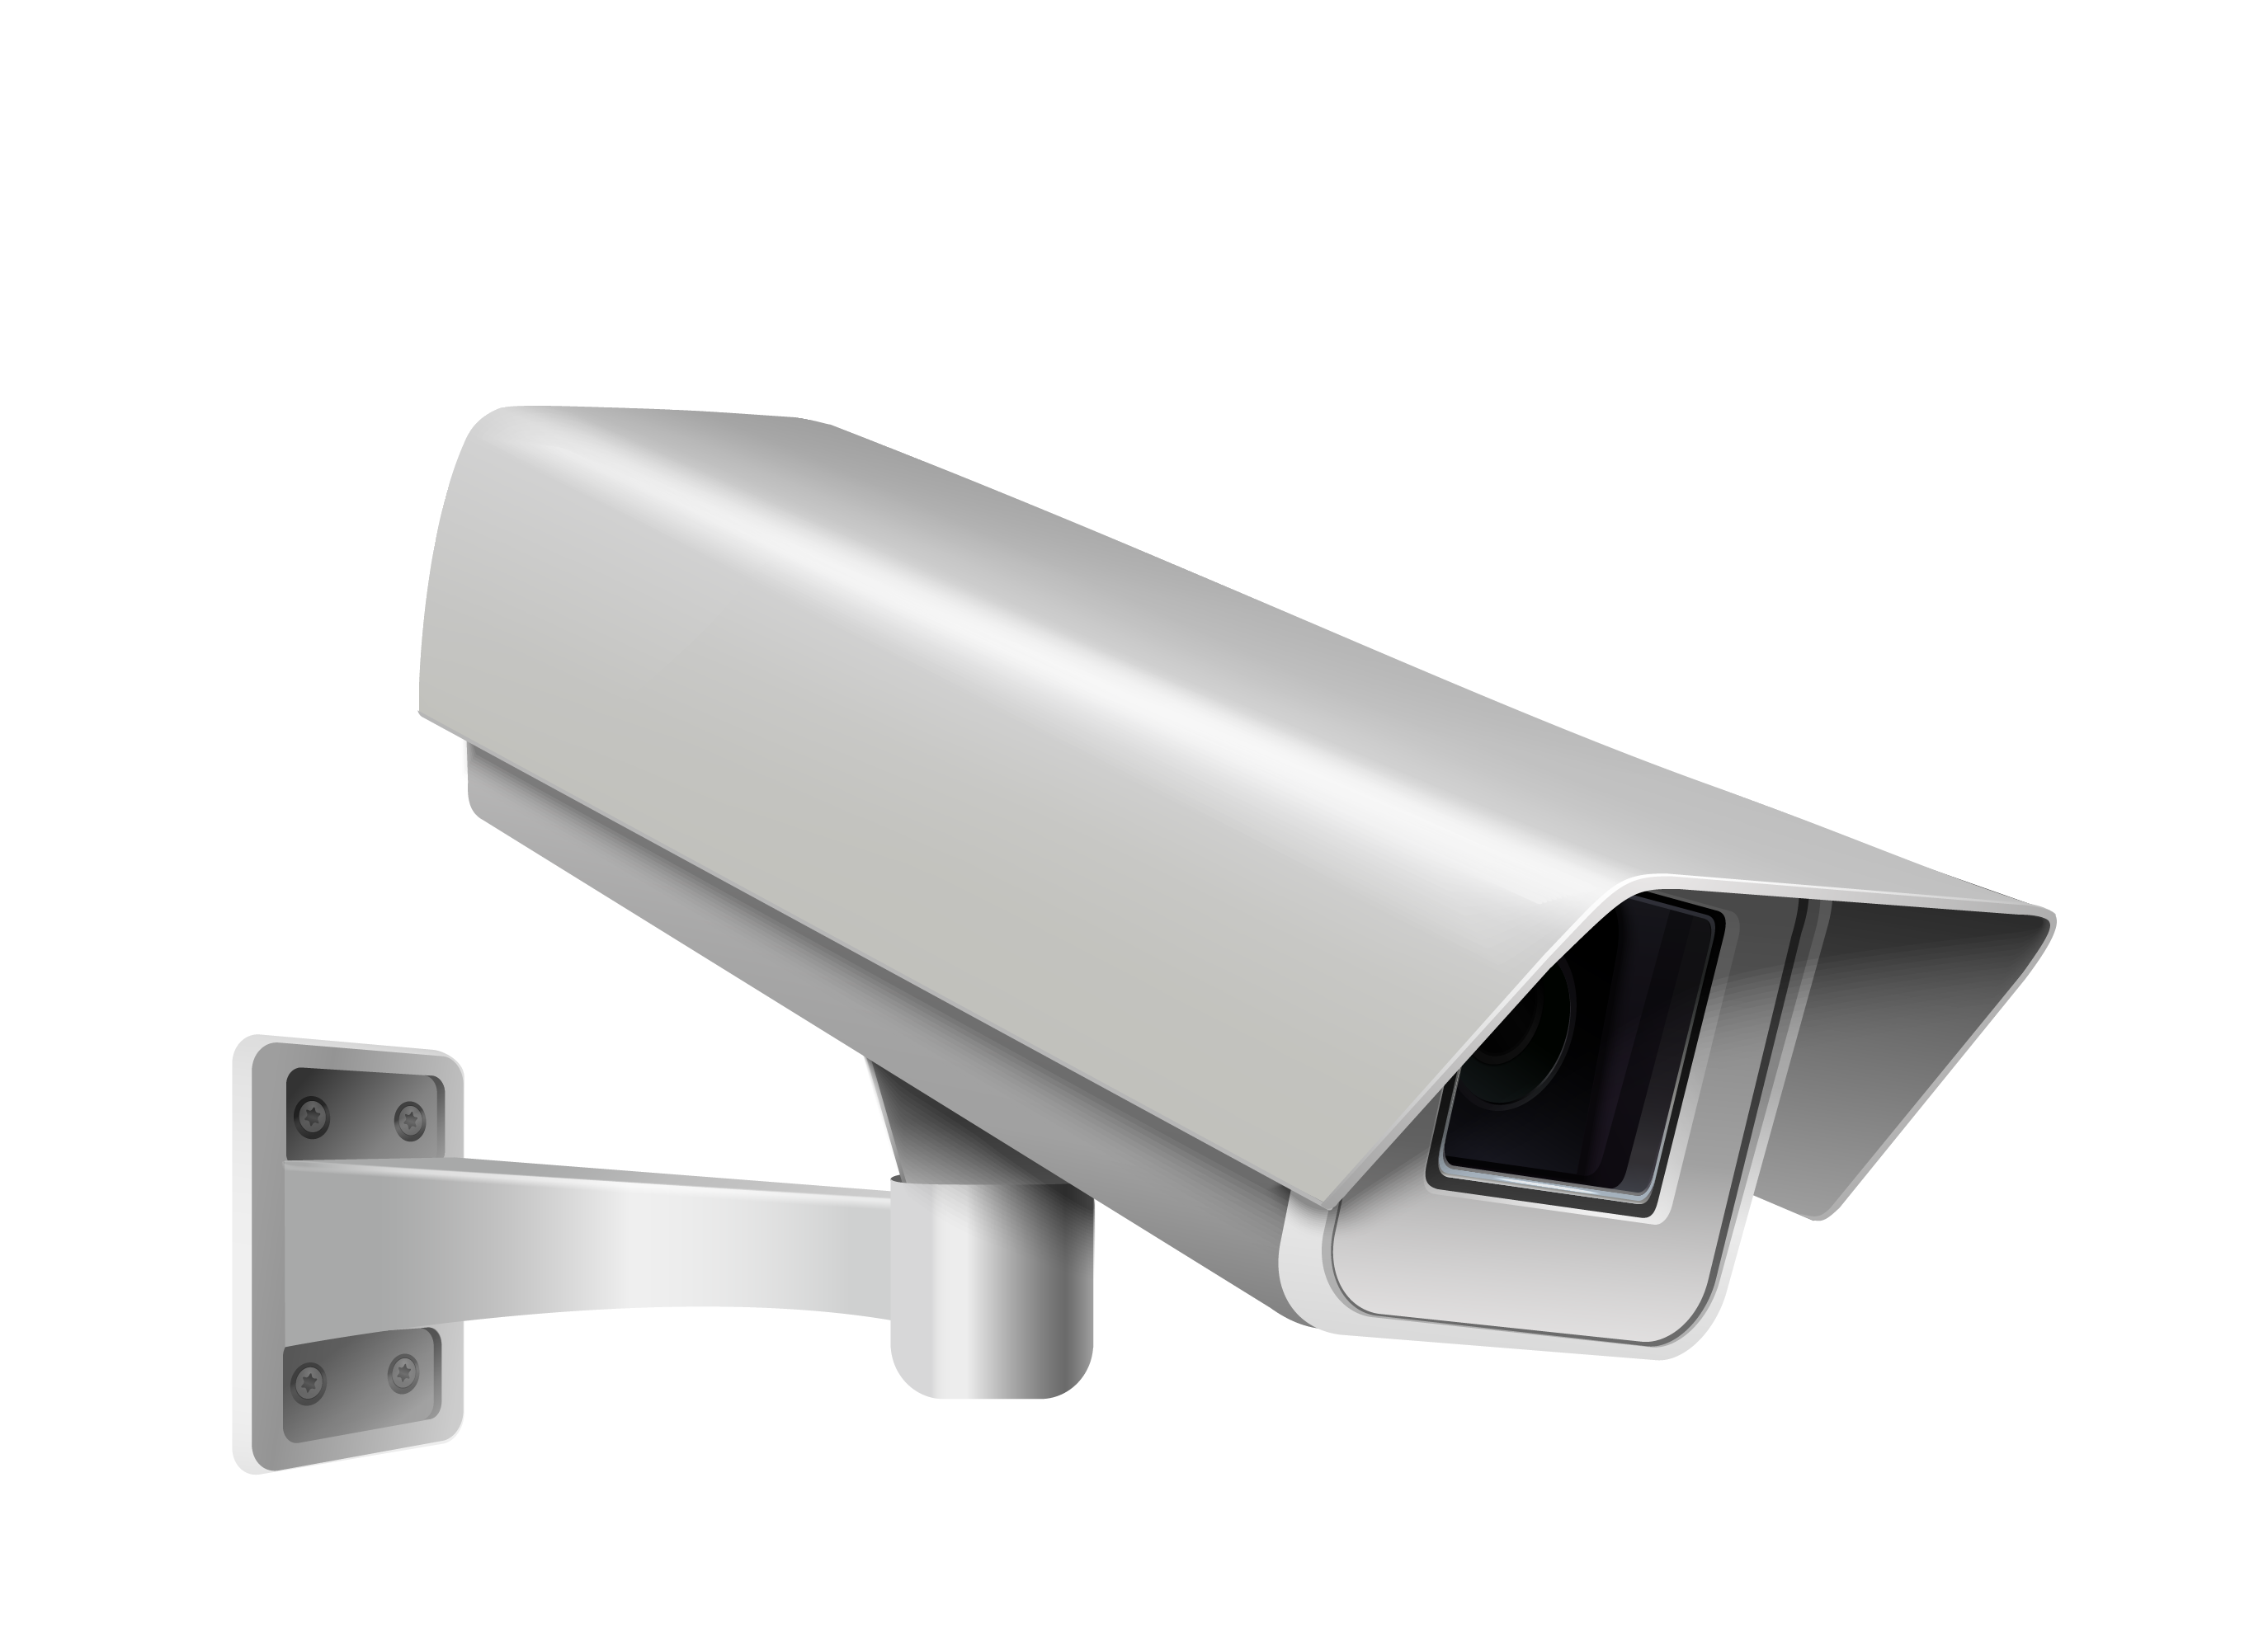


Intruder alert
Intruder alert

Slide 7

Fire alert
Fire alert

Slide 8
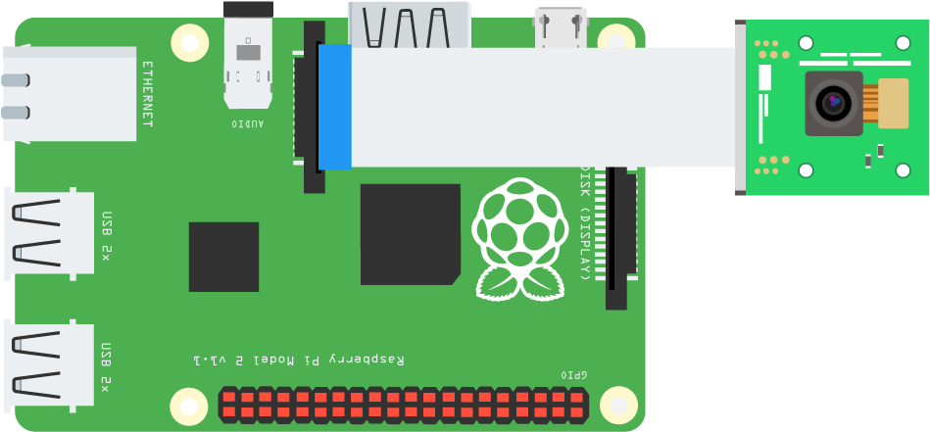
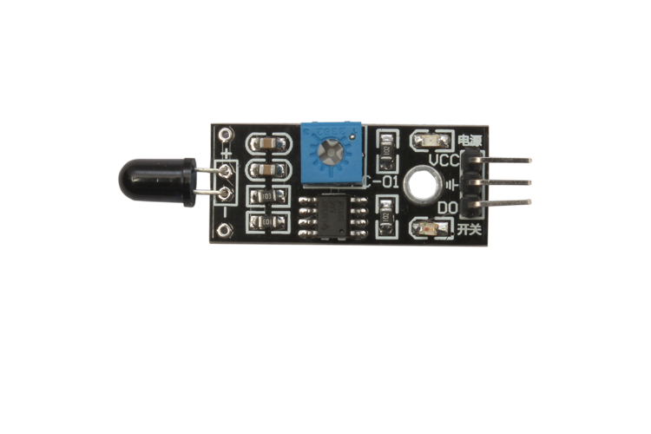
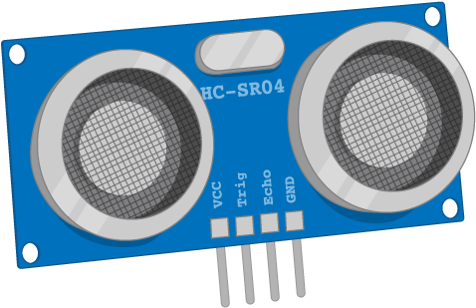
Circuit Diagram
Raspberry Pi Board
Raspberry Pi Camera
Flame Sensor
Ultrasonic Sensor

Slide 9
Block Diagram
Ultrasonic Sensor
Flame Sensor
Intruder Detected
Fire Detected
Camera
If Intruder Detected
Raspberry Pi
If Intruder Detected
Voice Alert
Mail Stored Image to User
Capture Image
Store Image To Specified Path
If Fire Detected
Voice Alert
Mail Static Image to User

Slide 10
Components
Raspberry Pi
Raspberry Pi Camera Module
Memory SD Card
PIR Sensor/Ultrasonic Senser
Speaker
Raspberry Pi Camera Connector
5V Power Adapter, Connector
LED’s
Buzzers
Flame sensor

Slide 11
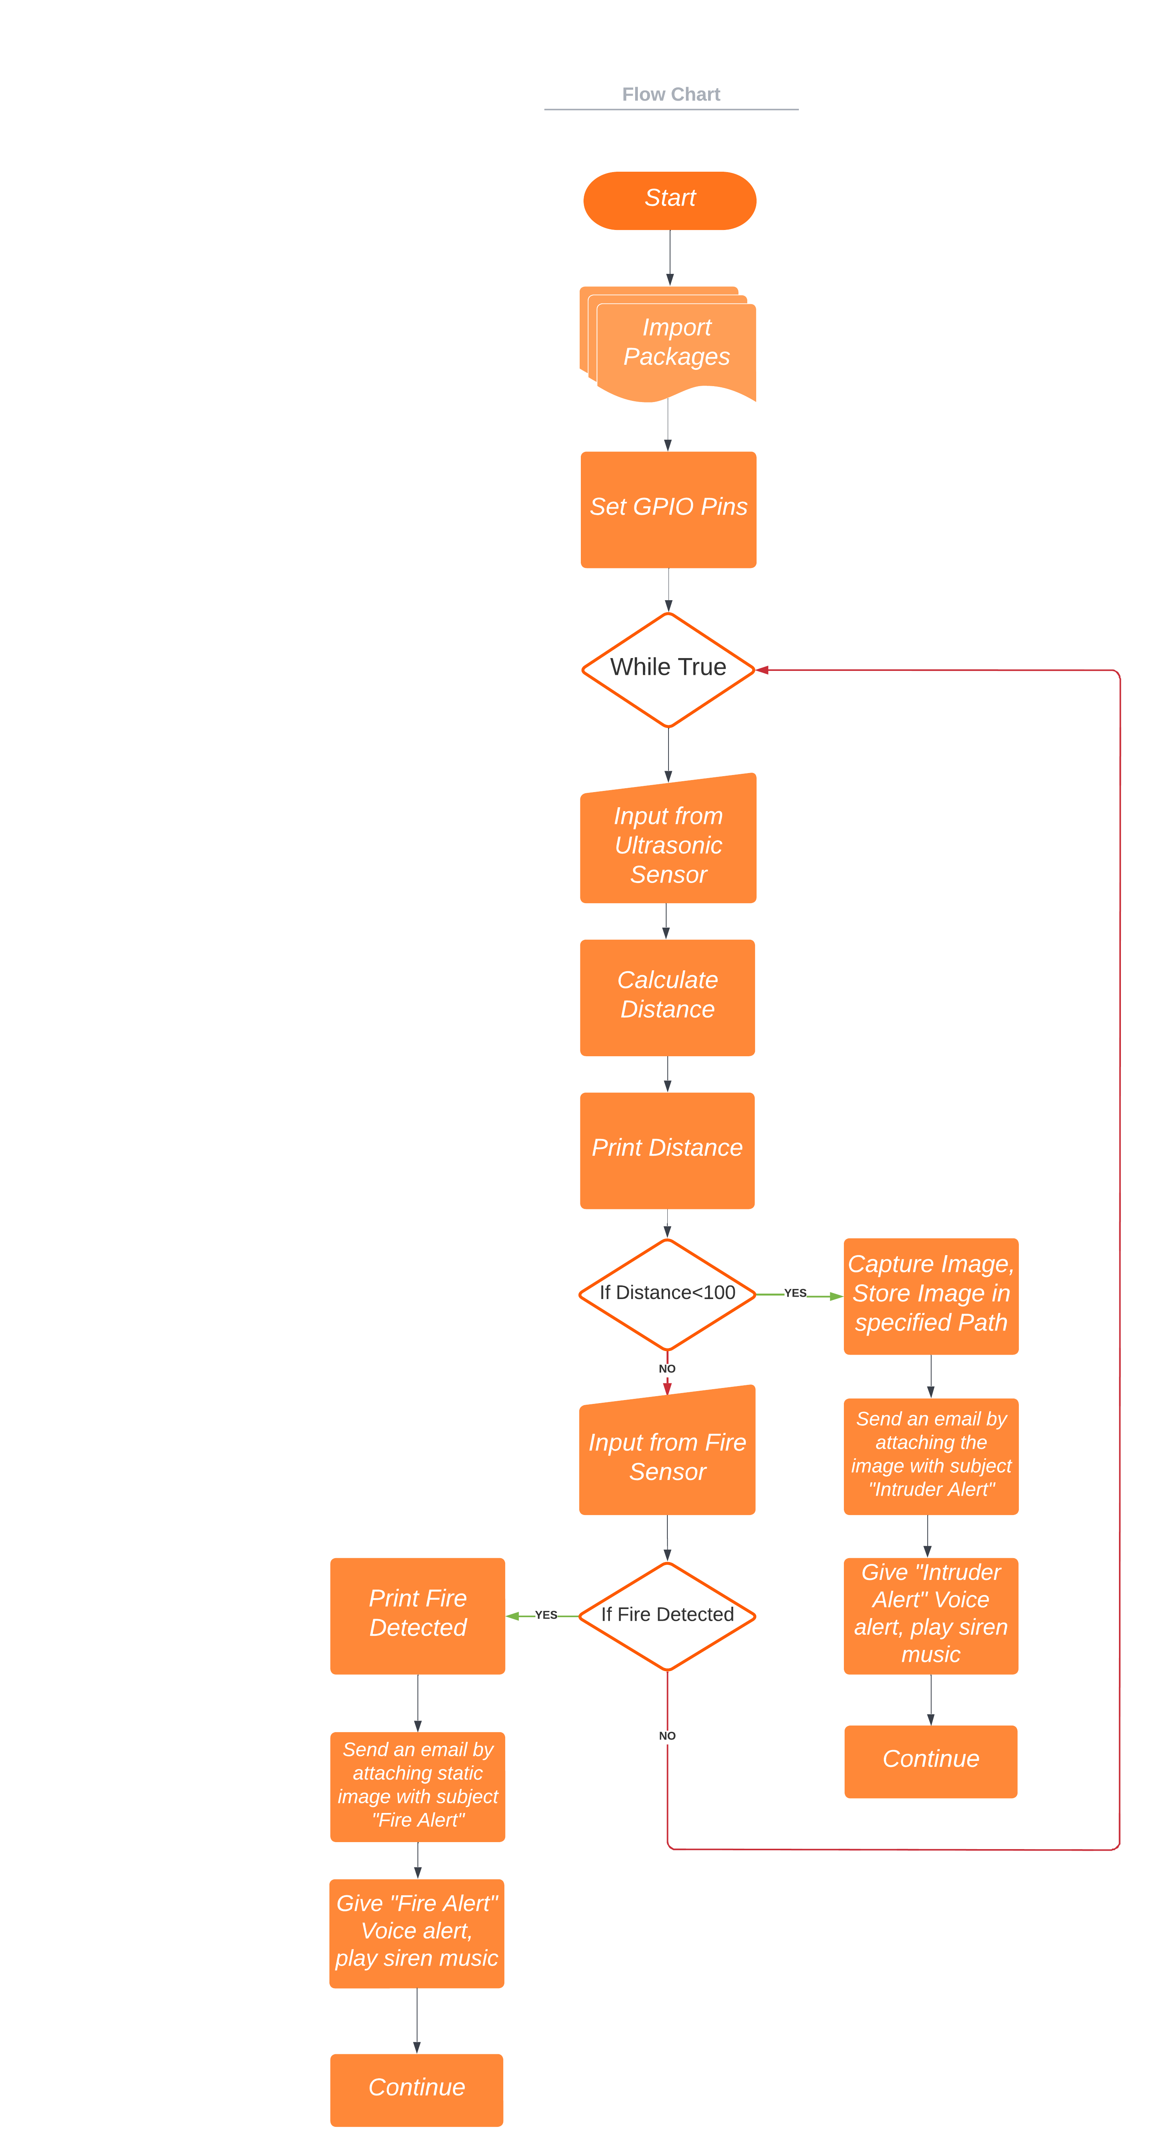
Code Flowchart:
1
2
1
2

Slide 12
Code:
import smtplib,ssl
from picamera import PiCamera
from time import sleep
from email.mime.multipart import MIMEMultipart
from email.mime.base import MIMEBase
from email.mime.text import MIMEText
from email.utils import formatdate
from email import encoders
import RPi.GPIO as GPIO
import time
TRIG=21
ECHO=20
GPIO.setmode(GPIO.BCM)
while True:
print("distance measurement in progress")
GPIO.setup(TRIG,GPIO.OUT)
GPIO.setup(ECHO,GPIO.IN)
GPIO.output(TRIG,False)
print("waiting for sensor to settle")
time.sleep(0.2)
GPIO.output(TRIG,True)
time.sleep(0.00001)
GPIO.output(TRIG,False)
while GPIO.input(ECHO)==0:
pulse_start=time.time()
while GPIO.input(ECHO)==1:
pulse_end=time.time()
pulse_duration=pulse_end-pulse_start
distance=pulse_duration*17150
distance=round(distance,2)
print("distance:",distance,"cm")
time.sleep(2)
if distance<100:
camera = PiCamera()
camera.start_preview()
sleep(5)
continued…
camera.capture('/home/pi/image.jpg') # image path set
sleep(5)
camera.stop_preview()
def send_an_email():
toaddr = 'intruderalertingsystem@gmail.com' # To id
me = 'intruderalertingsystem@gmail.com' # your id
subject = ”Intruder Alert!" # Subject
msg = MIMEMultipart()
msg['Subject'] = subject
msg['From'] = me
msg['To'] = toaddr
msg.preamble = "test "
#msg.attach(MIMEText(text))
part = MIMEBase('application', "octet-stream")
part.set_payload(open("image.jpg", "rb").read())
encoders.encode_base64(part)
part.add_header('Content-Disposition', 'attachment; filename="image.jpg"') # File name and format name
msg.attach(part)
try:
s = smtplib.SMTP('smtp.gmail.com', 587) # Protocol
s.ehlo()
s.starttls()
s.ehlo()
s.login(user = 'intruderalertingsystem@gmail.com', password = 'jarvis@123') # User id & password
#s.send_message(msg)
s.sendmail(me, toaddr, msg.as_string())
s.quit()
#except:
# print ("Error: unable to send email")
except SMTPException as error:
print ("Error") # Exception
send_an_email()

Slide 13
Code for voice alerts
import RPi.GPIO as GPIO
import time
from subprocess import call
import pygame
TRIG=21
ECHO=20
GPIO.setmode(GPIO.BCM)
while True:
print("distance measurement in progress")
GPIO.setup(TRIG,GPIO.OUT)
GPIO.setup(ECHO,GPIO.IN)
GPIO.output(TRIG,False)
print("waiting for sensor to settle")
time.sleep(0.2)
GPIO.output(TRIG,True)
time.sleep(0.00001)
GPIO.output(TRIG,False)
while GPIO.input(ECHO)==0:
pulse_start=time.time()
while GPIO.input(ECHO)==1:
pulse_end=time.time()
pulse_duration=pulse_end-pulse_start
distance=pulse_duration*17150
distance=round(distance,2)
print("distance:",distance,"cm")
time.sleep(2)
if distance<150:
call(["espeak","-s140 -ven+18 -z","Intruder Alert"])
pygame.mixer.init()
pygame.mixer.music.load("siren.wav")
pygame.mixer.music.play()
while pygame.mixer.music.get_busy() == True:
continue

Slide 14
Code:
import RPi.GPIO as GPIO
import time
from subprocess import call
import pygame
#GPIO SETUP
channel = 20
GPIO.setmode(GPIO.BCM)
GPIO.setup(channel, GPIO.IN)
GPIO.setwarnings(False)
while True:
if(GPIO.input(20)==False):
print("flame detected")
call(["espeak","-s140 -ven+18 -z","Fire Detected"])
pygame.mixer.init()
pygame.mixer.music.load("siren.wav")
pygame.mixer.music.play()
while pygame.mixer.music.get_busy() == True:
continue

Slide 15
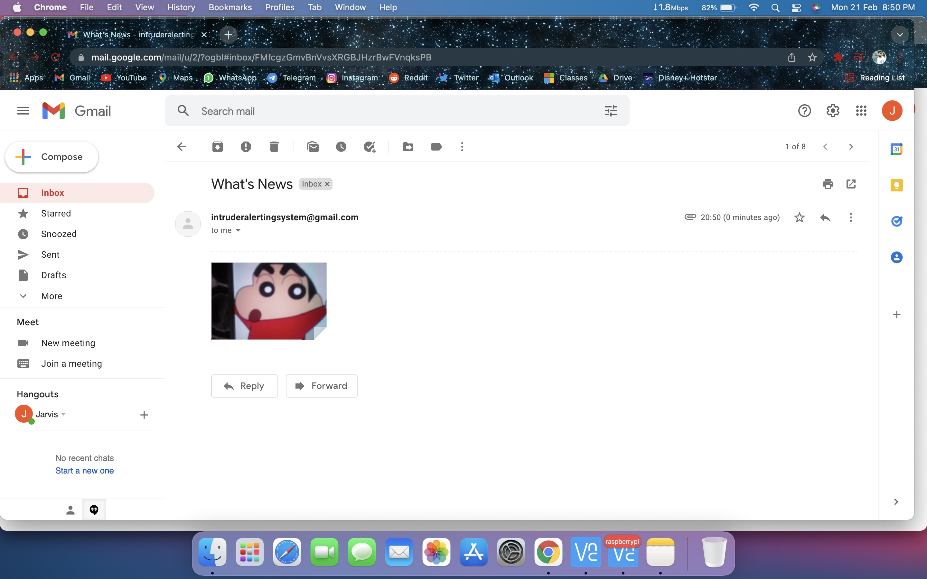
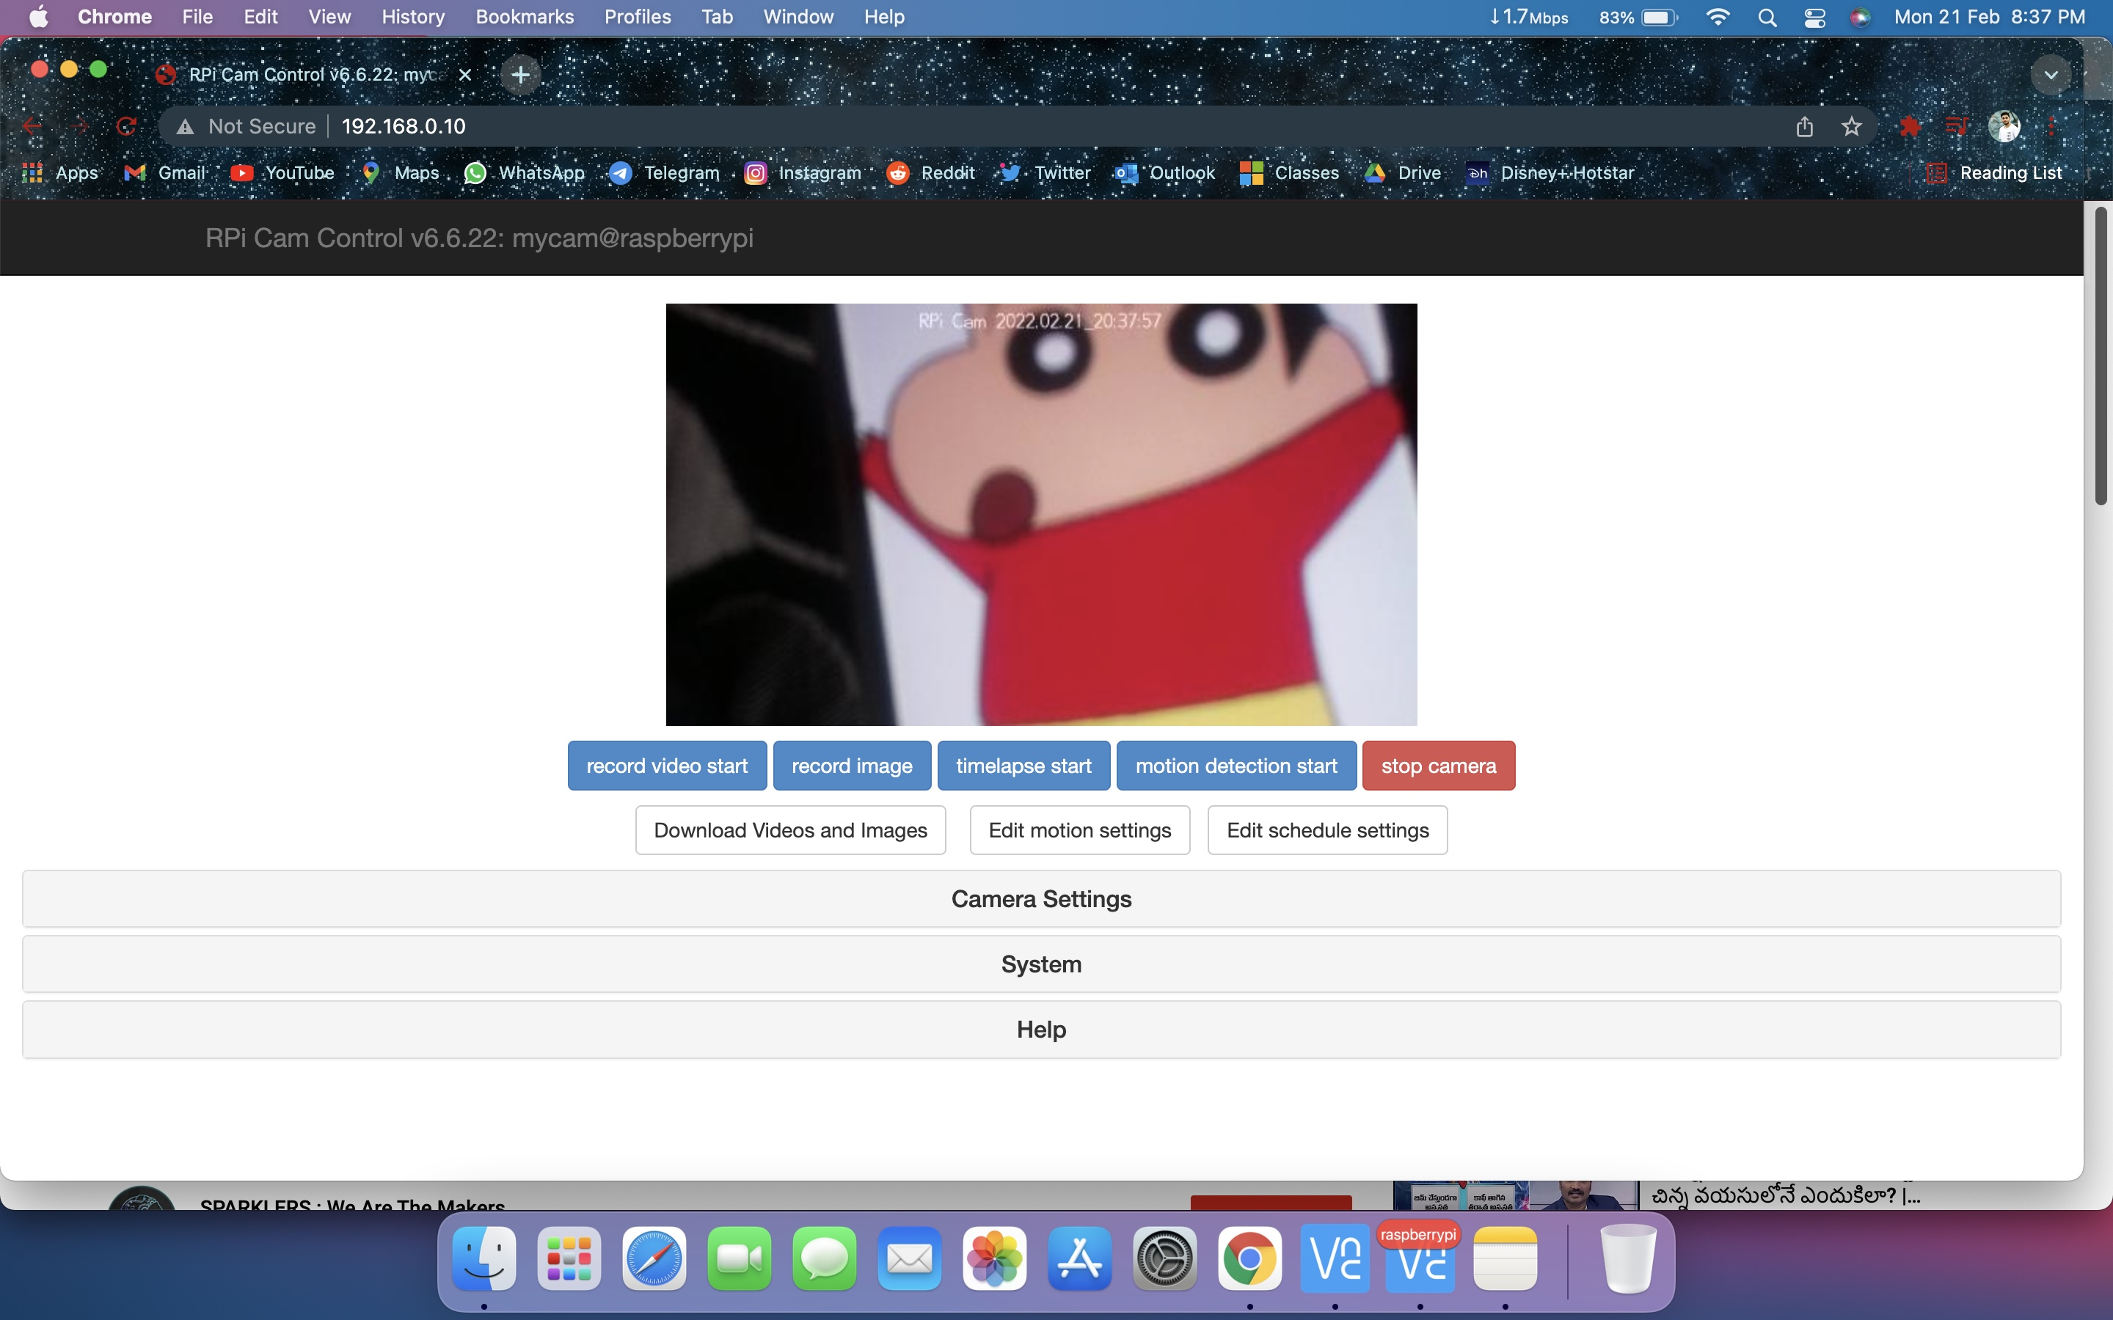
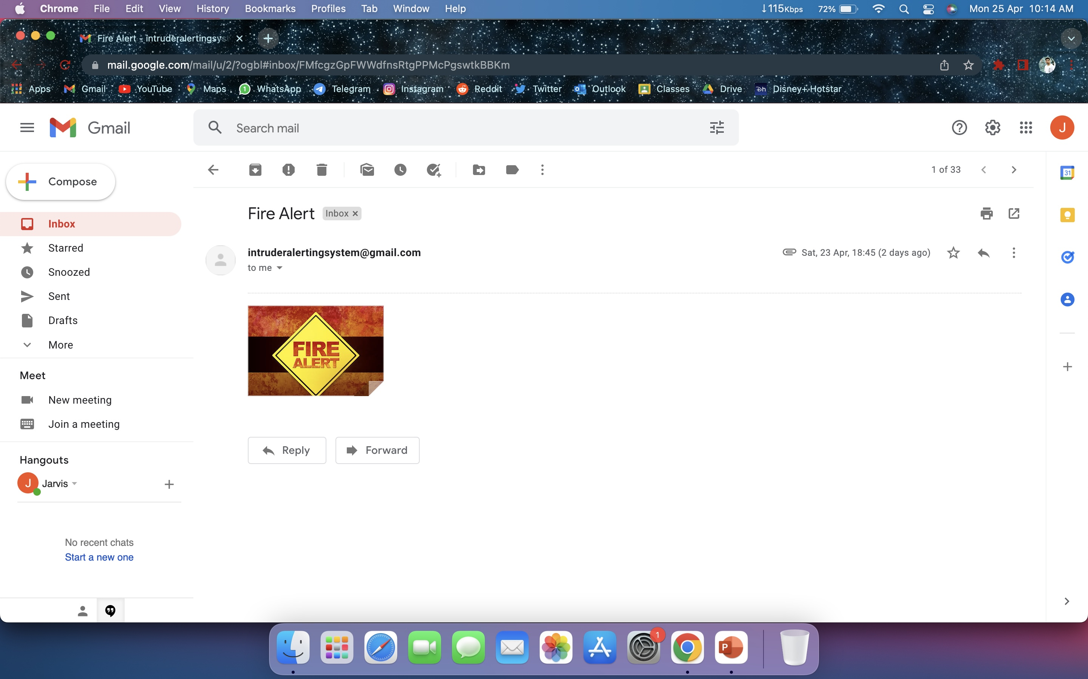
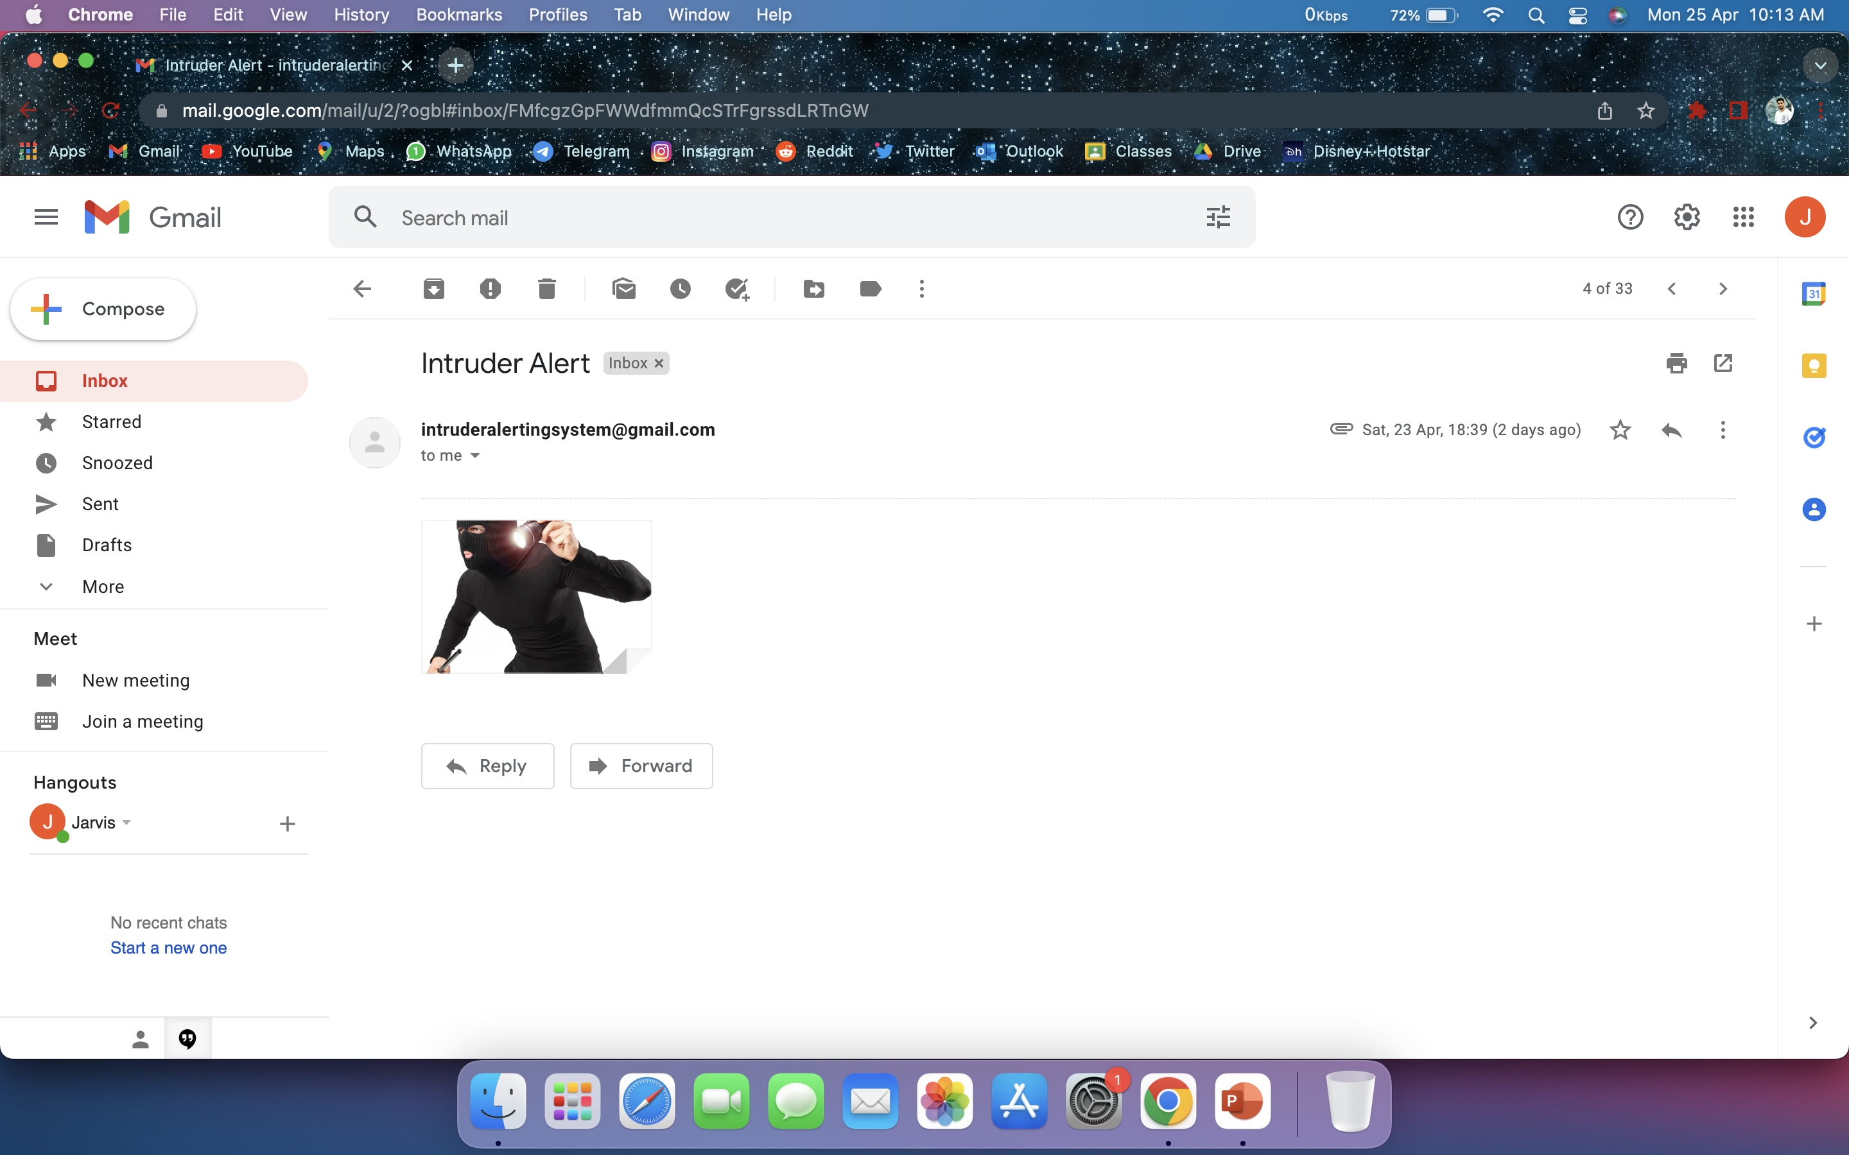
Alerting System
Alerting via email in image (i)
Real-time video streaming in image (ii)
Fire alert via email image (iii)
Intruder alert via email (iv)

Slide 16
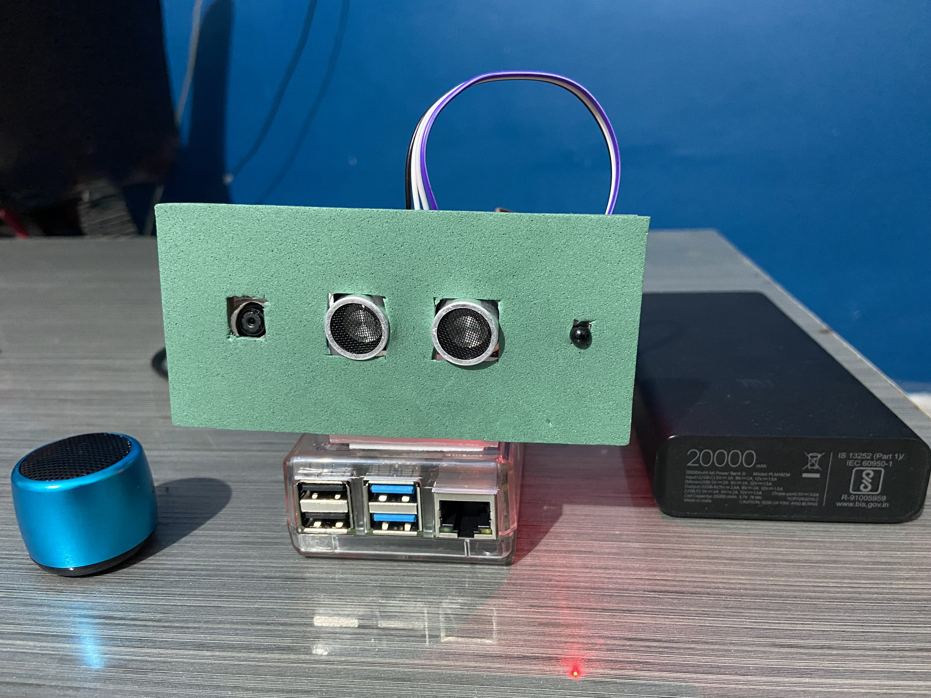
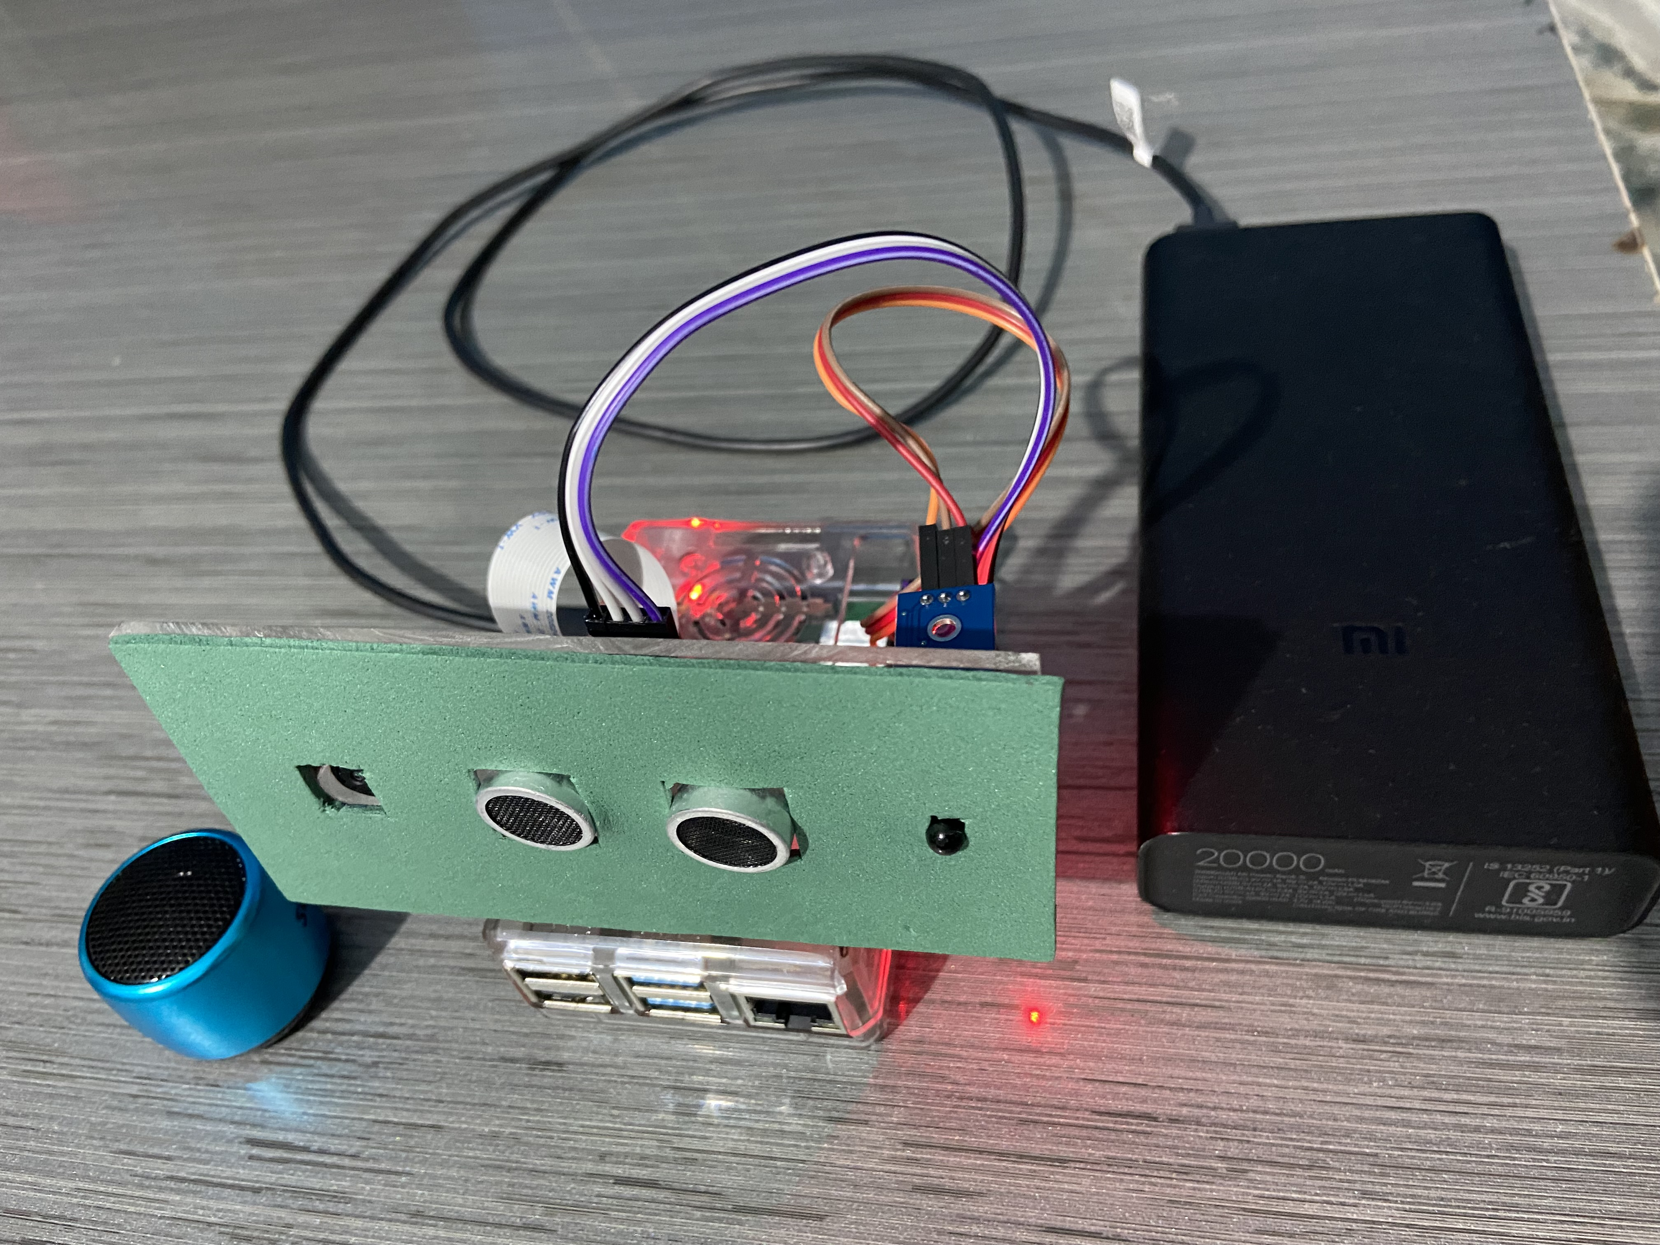
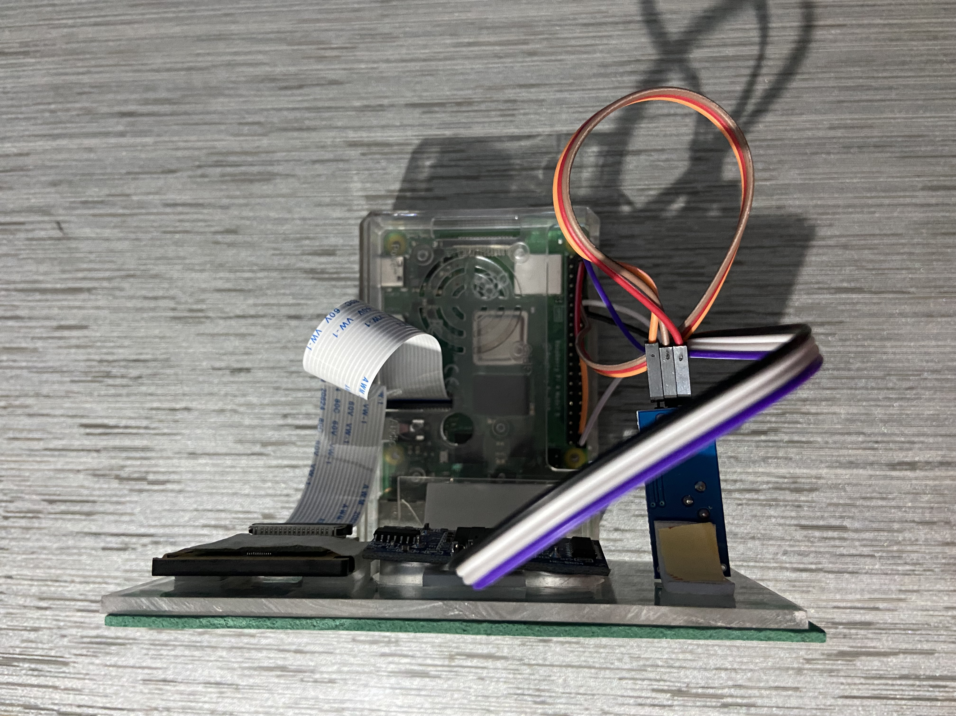
Prototype

Slide 17
Breakdown of Product Cost Total: ₹2450

Slide 18
Literature Review
Security is the condition of being protected against danger, loss, and criminals. In the general sense, security is a concept similar to safety.
The slight difference between the two is an added importance on being protected outside threats or dangers. Individuals or actions that go or act against the general rules of protection are responsible for the breach of security.
Attributes of a Good Security System :
Sensitivity: the system must be sensitive enough to detect threats or changes in the environment.
Reliability: the system must be dependable i.e. it must work in the environment its placed in.
Durability: it must be “rugged” i.e. work efficiently for a long time or a reasonable period.
Ease of deployment: it must be easy to transport and set up.

Slide 19
Advantages
Very small space required as compared to existing available surveillance systems in the market.
Cost-efficient compared to available surveillance systems.
Wireless transmission, hence there is minimal data loss and time delay.
Quick, Easy and inexpensive installation.
There is no requirement of a surveillance room or center, one can observe it from anywhere at any time.

Slide 20
Applications
Home security system
In hospital for patient surveillance
Intruder awakening alarms
Can be used at traffic signals, junctions and lonely streets to monitor activity
In city buses or Wi-Fi enabled trains to reduce the crime
In companies where surveillance is needed
Applicable to many areas

Slide 21
Conclusion
The Intrusion Detection and Alerting System using Raspberry Pi have been designed so that it can fulfill the user's needs for a particular surveillance area.
Raspberry Pi opens up a completely new chapter when it comes to technology today, not simply because of its size but because of its capabilities. Security will continue to be an issue for years to come.
However, with tools such as The Intrusion Detection and Alerting System using Raspberry Pi counters the threat of home security should be a reliable solution.
This project is basically to build a cost-effective and low-power consumptive web surveillance and fire safety system. This system has very good efficiency since raspberry pi itself is a microcomputing system, the camera module is capable of shooting high-definition videos like 720p and 1080p resolutions and also able to give voice alerts to alert the area about possible intruder and fire accidents.
So where ever the system is installed camera shoots the video in the vicinity of the camera. The output can be checked with help of the IP address obtained by a raspberry pi

Slide 22
References
https://www.analyticsinsight.net/raspberry-pi-the-next-revolution-in-the-internet-of-things/#:~:text=Raspberry%20Pi%20(RPi)%20defines%20as,languages%20like%20Scratch%20and%20Python.
https://www.raspberrypi.com/documentation/computers/configuration.html
https://projects.raspberrypi.org/en/projects/getting-started-with-picamera/2
https://learn.adafruit.com/pir-passive-infrared-proximity-motion-sensor/how-pirs-work
https://en.wikipedia.org/wiki/Intrusion_detection_system
Journal of Computing, Volume 1, Issue 1, December 2009, ISSN: 2151-9617 Design of an Automated Intrusion Detection System incorporating an Alarm https://www.researchgate.net/publication/45891252_Design_of_an_Automated_Intrusion_Detection_System_incorporating_an_Alarm
ICCIDS 2019 Home Security against Human Intrusion using Raspberry Pi Published by Elsevier B.V https://www.sciencedirect.com/science/article/pii/S1877050920306657

Slide 23
Thank You

